Slide 1
Monte Carlo
π Estimator
E
presented by
submitted to
Ali Jaafar 6411
Alaa Yehia 6432
Dr. Mohammad Aoudi

Slide 2


xecutive
Summary
E
E
This project implements a Monte Carlo Pi Estimator in Java using both sequential and parallel approaches. By comparing performance across large sample sizes, we demonstrate how multithreading significantly improves execution time without sacrificing accuracy. The project highlights the value of concurrency in numerical simulations and sets the stage for future enhancements like user-defined thread counts and advanced random generators.

Slide 3

E
Monte Carlo Simulation is a random sampling technique used for:
Numerical integration
Risk analysis
Solving deterministic problems
Why π?
π appears in geometry, physics, and science. Estimating it is a classic problem.
The Idea:
Generate random points in a unit square
Count how many fall inside the unit circle
Use the ratio to approximate π:
π≈4×Points in circle/Total points
I
ntroduction

Slide 4


E
E

Slide 5
E
E

Slide 6
E
E

Slide 7

E
M
otivation
Goal
Implement and compare sequential vs. parallel versions of π estimation using Monte Carlo.
Multi-core CPUs are common
Performance can be significantly improved
Ideal for CPU-bound simulations
Why Parallelism?
Objective
Write clean, efficient code
Measure real-time speedup
Visualize and analyze results

Slide 8

E
M
ethodology
Algorithm
Sequential Version
Parallel Version
Generate random (x, y) points in a unit square; count how many fall in the unit circle.Keep count of "hits" inside circle. Estimate π
Single-threaded loop with java.util.Random
Uses ExecutorService, Callable, and CompletionService for multi-threaded execution

Slide 9


Java Concurrency API
Utilized ExecutorService, Callable, and Futures for multithreaded execution
XChart
Used for plotting and visualizing performance comparisons
E
GitHub
Version control and collaboration through a shared repository.
T
echnologies

Slide 10
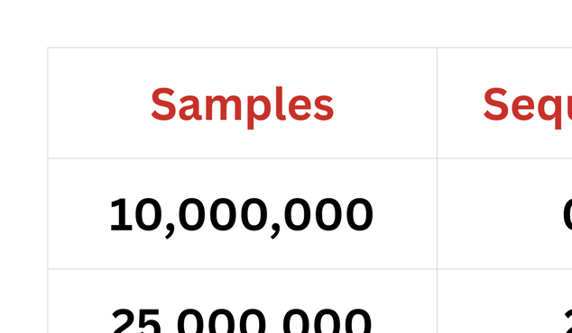
E
P
erformance
Benchmarks

Slide 11
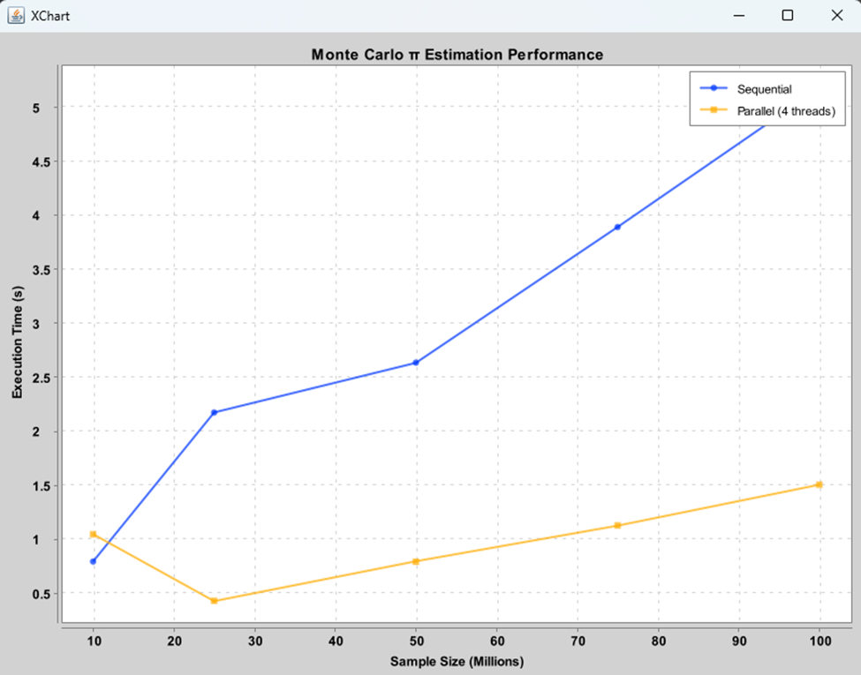
E
V
isual
Graph
Insights:
Parallel becomes faster as input size increases
Around 3.3x speed-up for large inputs
Thread overhead is visible at lower sample sizes

Slide 12
E
Advantages of Parallel Version
Significant speed-up
Efficient CPU core usage
Minimal memory overhead
Trade-offs
More complex implementation
Thread scheduling cost at small scales
S
equential vs.
Parallel

Slide 13
Future Work
Let user choose thread count
Try better RNGs (e.g., Sobol sequences)
Expand Monte Carlo to integrate other functions
Add more visuals like speed-up-only charts
E

Slide 14
E
Thank You
E

